Slide 1
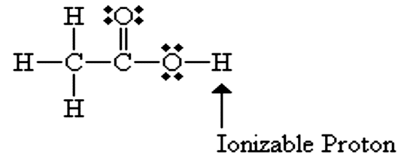
AlKarkh University of Science College of science First year level
General chemistry Labs
Supervisor: Dr. Mohammed Abdul Baset Assistant: Anssam Dhaher Huessin
Lab -10-
Titration of Acetic Acid in Vinegar
1. Introduction:
• Acetic Acid (from Latin acetum for vinegar) is the main component of Vinegar. It is a carbon based compound with a single ionizable proton, making it an organic acid of the larger class of organic acids called Carboxylic Acids; organic compounds with a -COOH functional moiety.
• Typically the Acetic Acid content of a vinegar will vary from about 5-8% for Table Vinegars to about 18% for Pickling Vinegars.
• In this experiment we will determine the percentage Acetic Acid (CH₃CO₂H) in Vinegar. We will do this by Titrating the Acetic Acid present with a Strong Base; Sodium Hydroxide (NaOH).
• The Endpoint of the Titration will be detected using a Phenolphthalein indicator; an acid-base indicator that changes color from clear to pink in going from its acidic form to its basic form.
• The chemical reaction has 1:1 stoichiometry.
CH3COOH (aq) + NaOH (aq) CH3COOH (aq) + H2O
2. Apparatus:
1- Stand & clamp.
2- Pipet bulbs.
3- Beaker.
4- Conical flask.
5- Dropper.
6- Burette.
30

Slide 2
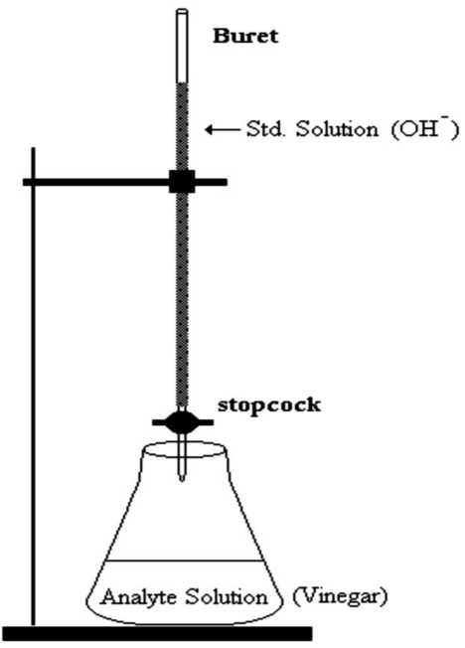
3. Materials:
1- Vinegar 10-mL burets.
2- Standardized 1.00 M NaOH.
3- Phenolphthalein.
4. Procedures:
A. Preparation of burette
1. Clean a 50 ml burette and rinse with DI water. A clean burette will have no droplets clinging to inside of the glass.
2. Rinse the buret with two 5 ml portions of the standardized NaOH solution. Make sure you drain the NaOH solution through the tip of the buret.
3. Using a funnel, fill the buret with the standardized NaOH solution. Make sure that the tip is also filled and there are no air bubbles in the tip.
4. Slowly drain the NaOH out of the buret until the buret reads 0.0 ml. Read from the bottom of the meniscus. It is sometimes helpful to hold a piece of paper with a black line behind the buret and line it up with the meniscus.
B. Preparation of the Vinegar solution
5. Pipet 5 ml of the vinegar solution into a clean 250 ml flask.
6. Add 50 ml of DI water to the flask.
7. Add two drops of phenolphthalein indicator.
C. Determination of % acetic acid in Vinegar solution
8. Place a white background underneath the flask with the vinegar solution.
9. Slowly add with constant swirling the NaOH drop wise to the vinegar solution.
31

Slide 3
10. Continue adding drop wise to the vinegar solution until the vinegar solution turns the faints shade of pink that remains for 30 seconds. This is called your endpoint.
11. Calculate the % by mass of acetic acid in the vinegar solution.
5. Calculation:
• The volume of NaOH added to the vinegar solution is read off the buret in milliliters and converted to liters (liters = ml / 1000).
• The moles of the sodium hydroxide used to react with the acetic acid in the vinegar solution can now be determined.
moles of NaOH = (molarity of NaOH) x (liters of NaOH) moles of NaOH = moles of acetic acid
• The mass of the acetic acid in the vinegar solution is determined by using the moles of acetic acid and the molecular mass of acetic acid (60 g/mol).
grams of CH3COOH = (molecular mass of CH3COOH) x (moles of CH3COOH)
In order to calculate the percent acetic acid in the vinegar solution by mass, we will assume the density of the vinegar solution is the same as water (1.00 g/ml).
grams of vinegar solution = density of vinegar solution x volume of vinegar solution
To calculate the % acetic acid by mass in the vinegar solution:
32

